Slide 1
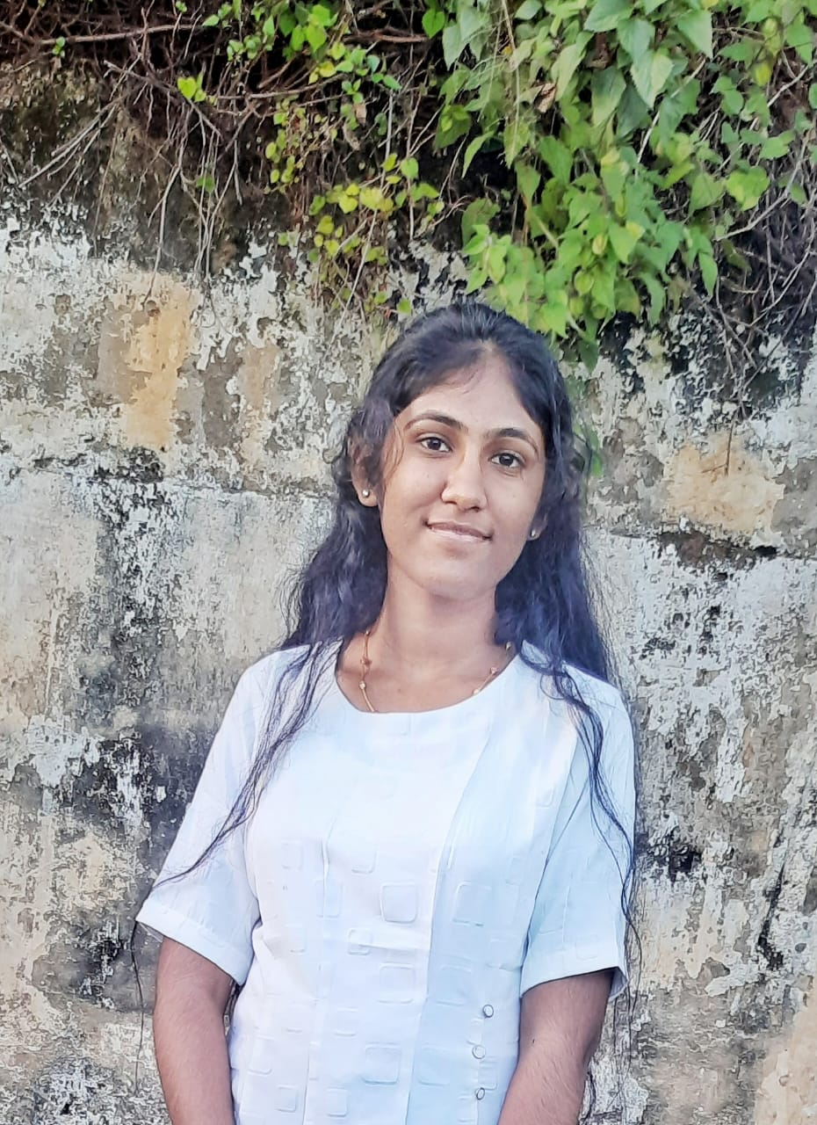
GEN AI VIRTUAL FASHION STYLIST APP
TEAM NAME: Red T-shirt
ABOUT ME:
Name:Vaishnavi S.
Background & Skills:
Completed an internship in artificial intelligence and data science, with strong skills in AI, machine learning, and data-driven solutions.
Passion & Vision:
I’m passionate about using technology to solve everyday challenges, especially in fashion, where personal style is important but often difficult to manage. I envision Red T-shirt as a platform that makes styling simple and accessible through AI.
Project Motivation:
I saw a need for a personalized, accessible fashion tool that uses AI to help people find outfits that match their unique style, body type, and preferences. Existing solutions lack this level of customization, and Red T-shirt aims to fill that gap.
Goal for This Project:
To create an AI-powered fashion stylist app that provides users with a personalized, trend-based styling experience, helping them feel confident and stylish every day.

Slide 2
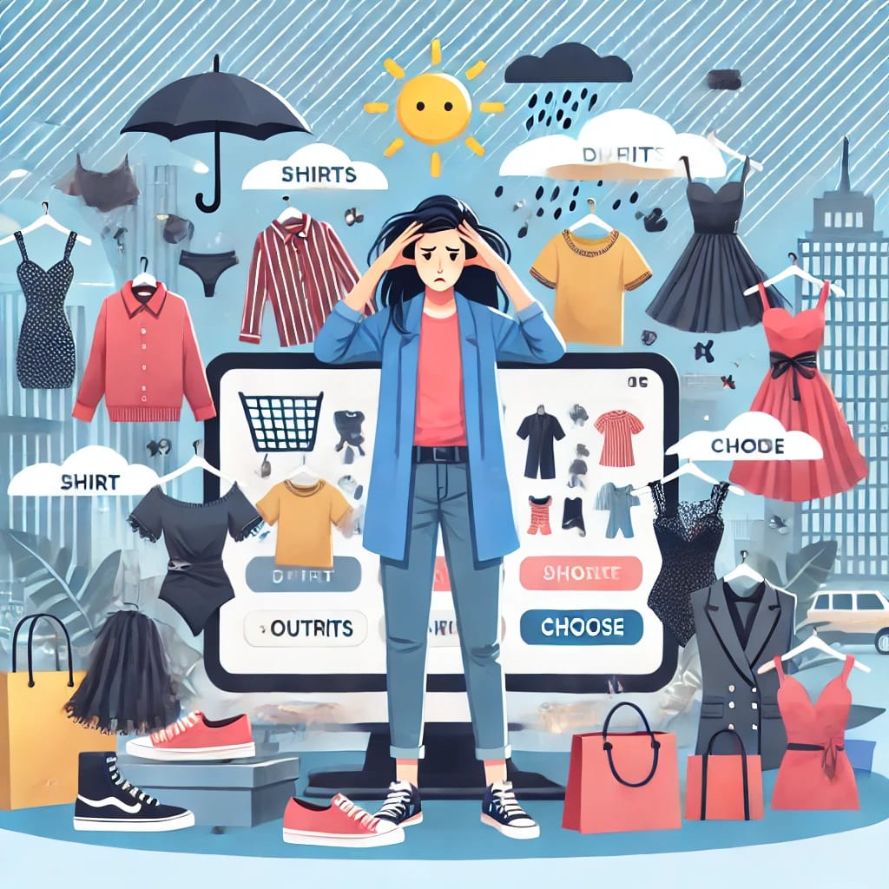
DESCRIPTION OF THE PROBLEM STATEMENT
Based on a number of different ecommerce studies, the average shopping cart abandonment rate is 68.81% with the most recent study showing 74.52%. 📊
Shopping for clothes online can be overwhelming due to the vast number of choices and lack of personalized options.
Customers struggle to find outfits that match their unique body type, fashion preferences, and specific occasions they are shopping for. Without tailored recommendations, they spend hours filtering through irrelevant options.
Traditional recommendation engines offer suggestions based on simple algorithms that fail to factor in nuanced preferences such as real-time weather conditions or seasonal trends, leading to uncomfortable or inappropriate outfit choices.
Fashion brands and e-commerce platforms face challenges in delivering personalized, AI-driven styling solutions that meet individual customer needs, often resulting in high cart abandonment rates.
Additionally, weather conditions and seasonal changes are rarely considered, leading to inappropriate outfit choices.
This leads to dissatisfaction, lower engagement, and diminished loyalty on fashion platforms, impacting overall conversion rates and revenue for e-commerce retailers
Many customers abandon shopping carts because they are unsure if an outfit will look good on them or if it’s suitable for an event or season.
This problem impacts user satisfaction, engagement, and loyalty on fashion platforms, leading to reduced conversion rates.

Slide 3
PROPOSED SOLUTION
TECHNOLOGY USED
Frontend – React js, Bootstrap
Backend(server and api) – node js with express
DataBase – MongoDB
Machine Learning and AI frameworks-
Scikit learn models, Tensorflow, Tensorflow serving, OpenCV, Stable Diffusion,Hugging face Transformers
Cloud Services & Hosting – aws,aws lambda
3D modeling – Blender
Virtual Trial (AR/VR) – ARCore, Unity
Security – JWT, SSL, OAuth
APIs - Weather api, Social media api,Fashion Retail api, GraphQL
Analytics – Google Analytics
Version Control - Github
To solve these problems we propose a Generative AI-powered Virtual Fashion Stylist that provides personalized outfit recommendations.
The AI analyzes users' body types, style preferences, and upcoming occasions and weather conditions to suggest tailored outfits.
Users can input specific events (e.g., weddings, business meetings) or casual day-to-day needs, and the stylist provides relevant suggestions.
Fashion brands and e-commerce platforms can use this tool to offer a customized shopping experience, boosting customer engagement and satisfaction.
Our AI stylist learns from user feedback and purchase history, refining recommendations to become increasingly accurate over time.
With easy integration into existing platforms, this solution enhances user experience, encourages sales, and reduces cart abandonment.

Slide 4
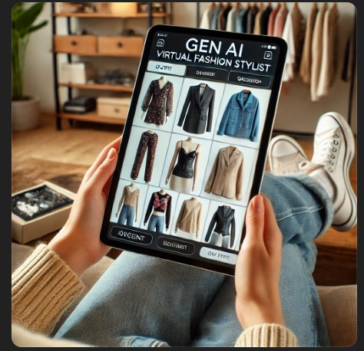
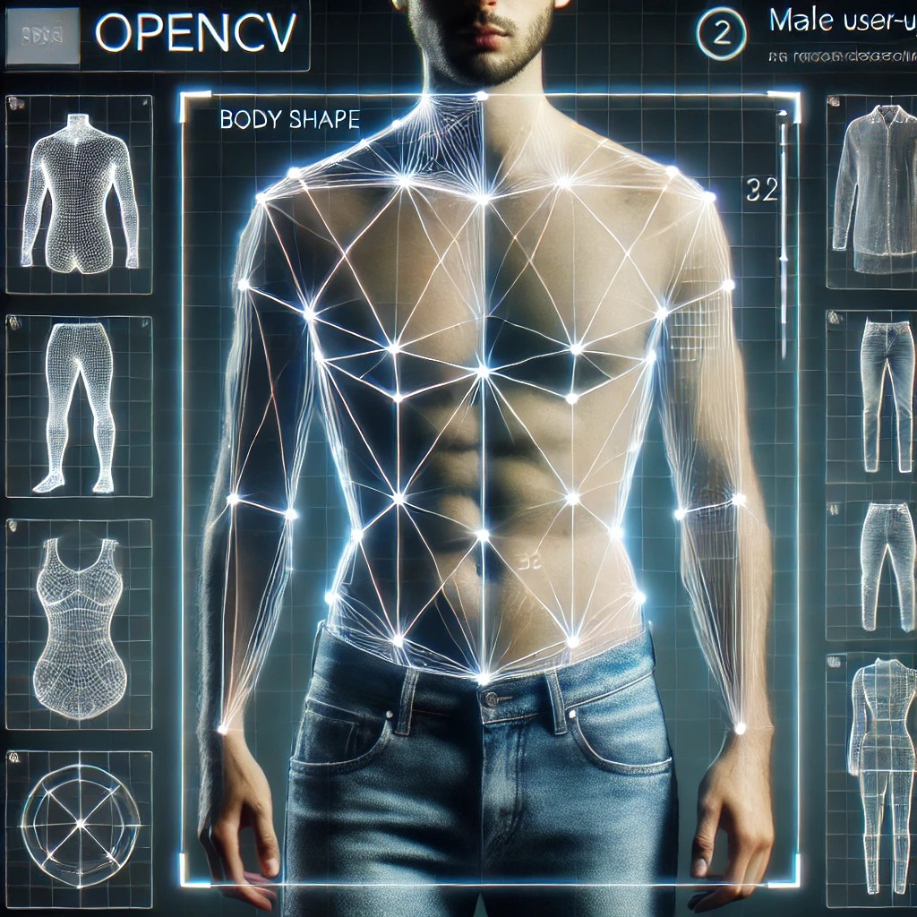

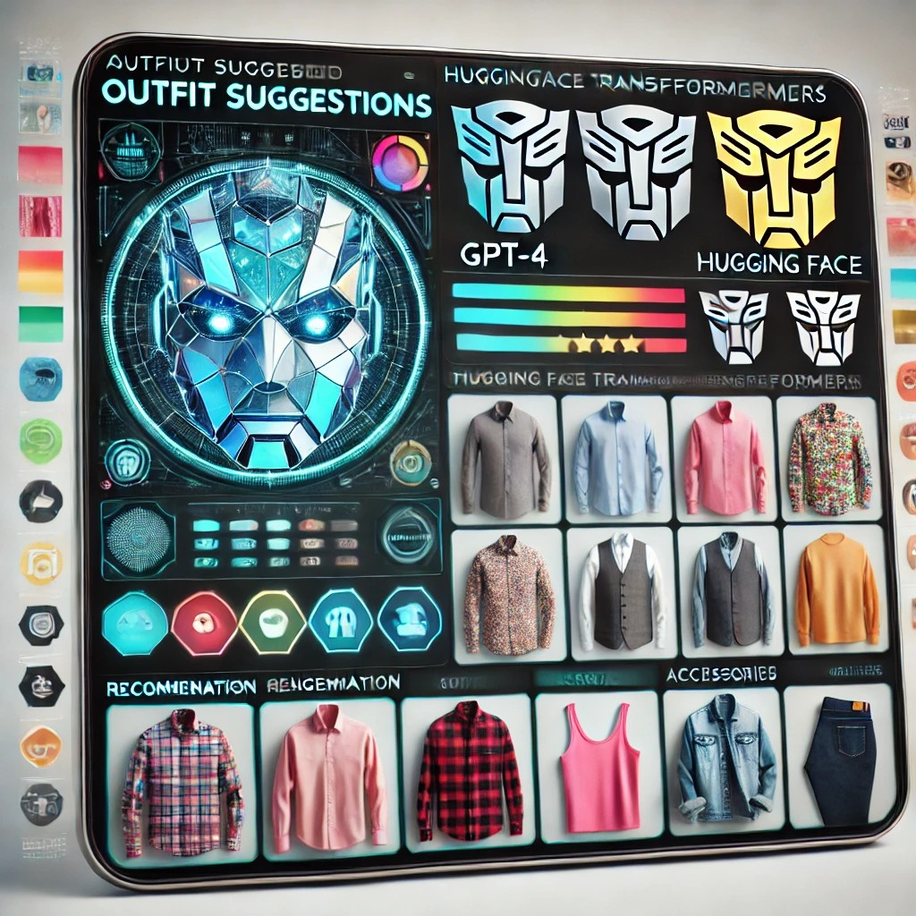
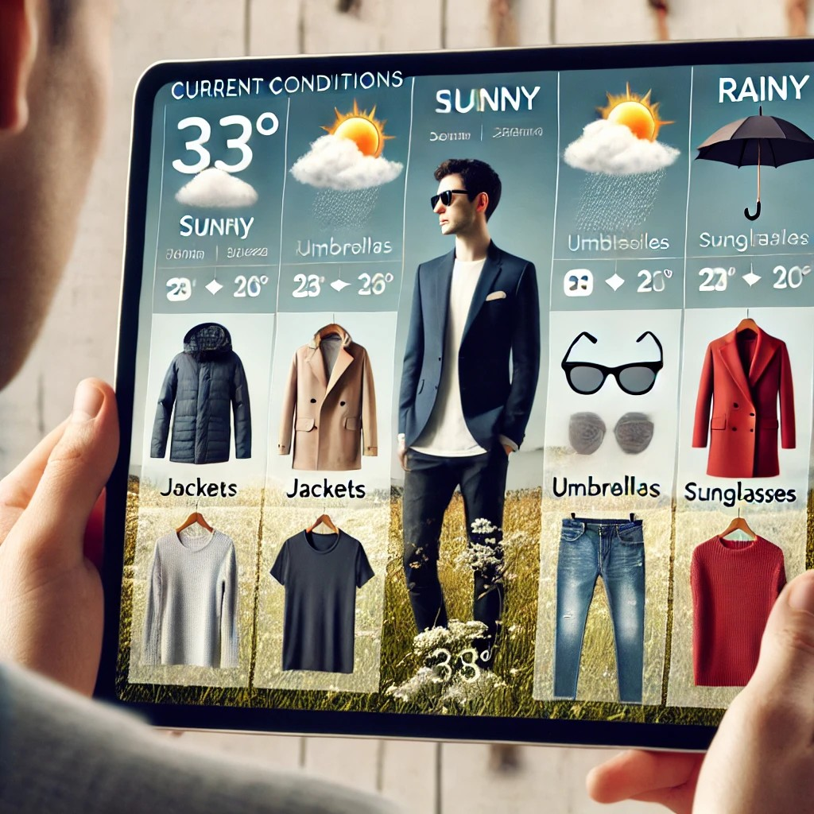
PROCESS OF PROPOSED SOLUTION
1. User Preferences
Users can enter their fashion choices, like body type, occasion, and style, or upload a photo to help create better outfit recommendations.
2. Body Type Analysis with OpenCV
Our app uses OpenCV to look at the uploaded photo and figure out the user’s body shape, helping to suggest clothes that fit them well.
3. Backend Processing
App's backend is built with Node.js, that takes the user’s preferences and sends them to the AI models that will create outfit suggestions.
4. AI-Powered Outfit Suggestions
Then it uses GPT-4 (an advanced AI) and Hugging Face Transformers to suggest outfits based on the user’s preferences and body type.
5. Weather-Appropriate Outfits
Checks the weather using the Open Weather API and makes sure the suggested clothes are suitable for the current weather conditions.

Slide 5
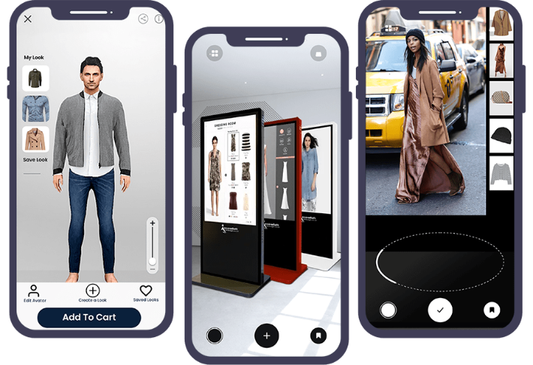
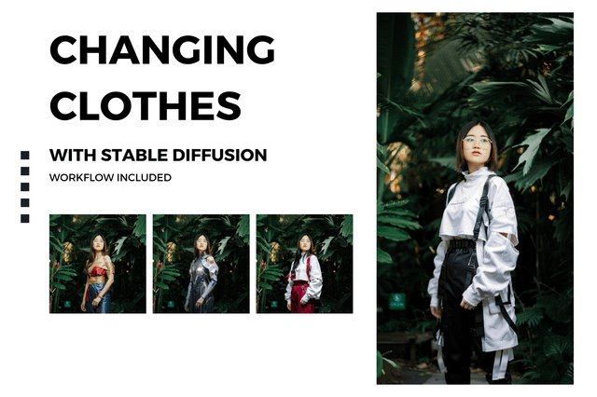
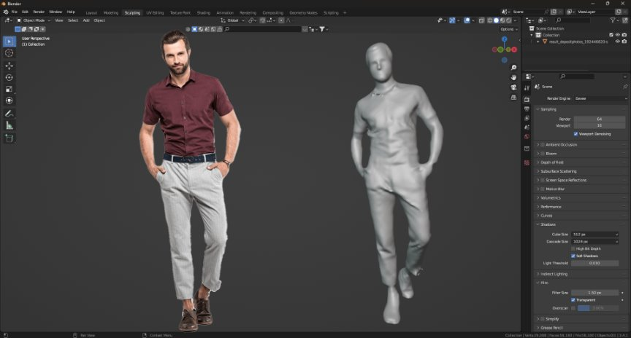



6. Virtual Try-On with AR/VR (ARCore & Unity)
The app uses ARCore and Unity for a Virtual Try-On experience where users can see how outfits look on them in real-time, using augmented reality (AR) or virtual reality (VR).
7. Outfit Images with Stable Diffusion
It uses Stable Diffusion to create high-quality images of the suggested outfits so users can see what the clothes look like.
8. 3D Modeling with Blender
Using Blender to create 3D models of the outfits and shows how the clothes would look on the user, offering a virtual try-on experience.
9. Smarter Recommendations with Scikit-learn
The app uses Scikit-learn to learn from the user’s previous choices and give smarter outfit suggestions in the future.
10. Personalized Models with TensorFlow
The app uses TensorFlow to improve and personalize outfit recommendations, making them more accurate over time as the user interacts more.
11. User Data and Security
The app securely stores user preferences and outfit history in MongoDB and AWS S3, and users log in safely using Firebase Authentication.

Slide 6
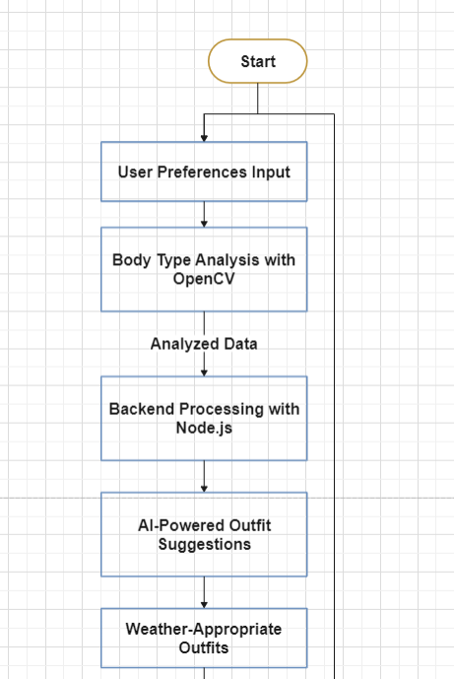
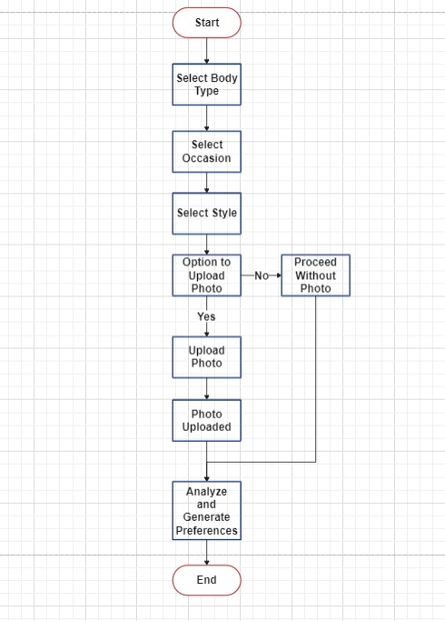
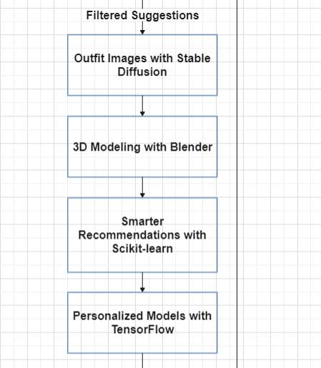
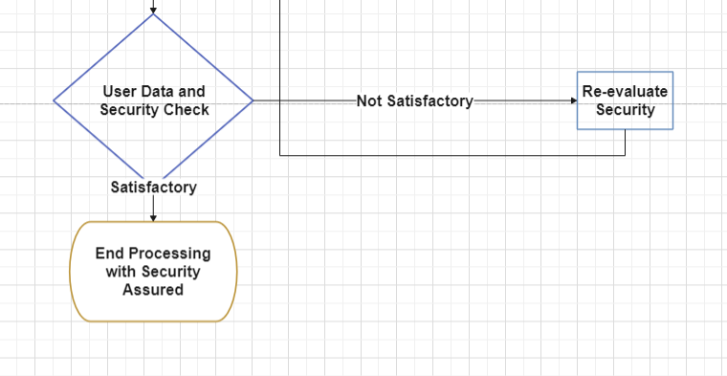
BRIEF FLOWCHART
DETAILED FLOWCHART

Slide 7
How does your innovation accelerate change with the power of Technology?
Personalization at Scale 🛠️👗
2.Democratizing Fashion Advice 🌍👗
3.Sustainability and Conscious Consumption♻️
4.Real-Time Decision-Making with Weather☁️🌞 and Trends 📈👗 5.Empowering E-Commerce 🛒💻👗 6.Trendsetting Through Generative AI ✨👗 🤖
7.Augmented Reality (AR) for Virtual Try-On 👗📱🕶️
Our Generative AI stylist revolutionizes fashion retail by offering hyper-personalized shopping experiences.
The AI leverages deep learning to understand individual preferences, body types, and lifestyle needs, creating a bespoke recommendation engine.
By considering real-time weather data and occasion-specific requirements, it provides the perfect balance of style and functionality.
The platform encourages faster decision-making, reduces returns, and enhances user satisfaction, promoting long-term brand loyalty.
By automating the process of outfit curation, fashion brands can focus on innovation, while customers enjoy a seamless and tailored shopping experience.
An AR virtual fashion stylist app allows users to virtually try on clothes and accessories using augmented reality. The app overlays digital fashion items onto a live camera feed, using body mapping for an accurate fit. It enhances the shopping experience by offering customization and easy purchasing through the app.

Slide 8
How is your solution different/unique from other solutions in market?
Our solution goes beyond simple algorithms by incorporating Generative AI for highly personalized and dynamic outfit recommendations.
It considers real-time weather data, ensuring that outfits are both stylish and season-appropriate.
The AI stylist evolves with user behavior, learning from feedback and adjusting suggestions to become more accurate over time.
Unlike existing tools, we focus on combining body type, occasion, and personal style preferences in one holistic platform.
Our stylist can integrate seamlessly with any e-commerce platform, providing a fully customizable and scalable solution.
Many people cannot afford a personal fashion stylist, making this generative AI app a valuable and accessible solution.
Our virtual fashion stylist differentiates itself by combining deep personalization, real-time AR try-ons, and trend-based AI-driven recommendations. Its focus on sustainability, advanced technology, and an integrated ecosystem for users and retailers puts it ahead of other solutions on the market, offering a richer, more tailored user experience
Generative AI in fashion is a relatively new field, and our use of tools like Stable Diffusion and Hugging Face Transformers allows for dynamic, AI-driven fashion design and recommendations. These models don't just recommend existing styles but can generate unique outfits or style combinations based on user preferences, previous purchases, body measurements, or social media activity

Slide 9
ONE-MINUTE VIDEO OF THE IDEA (PITCH VIDEO)
https://go.screenpal.com/watch/cZ61oUVWQXq
(Or)
https://youtu.be/LxfT1Yovgx0?si=C5l KGZgeKvZn-jcD

Slide 10
Thank you!

